Slide 1

1960 – 2020 Trend Study

Slide 2


From the 60’s…
to 2020…

Slide 3
Everything changed

Slide 4

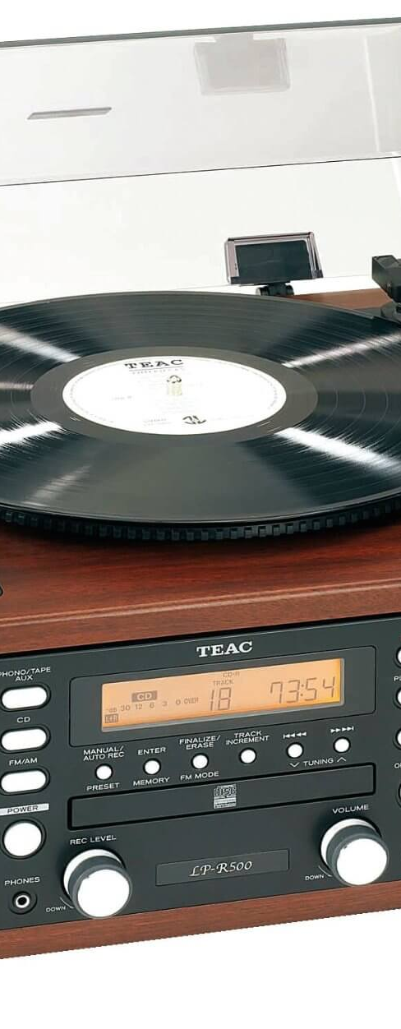
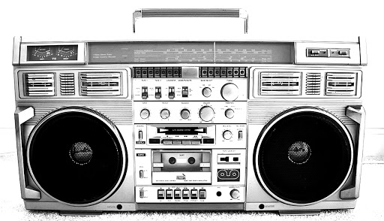

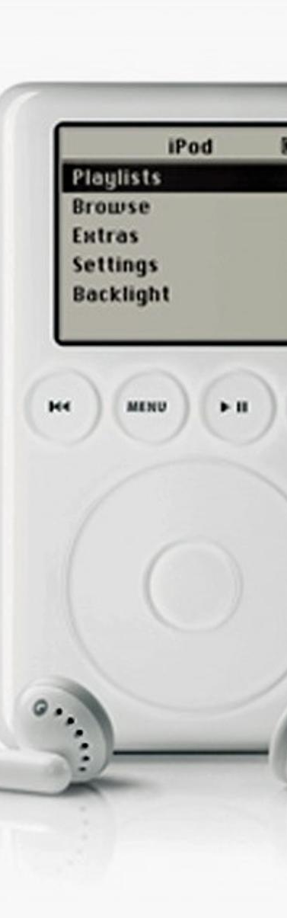


Slide 5

Is it easier or more difficult to become and stay No1 ?
Notes:
The aim of this quick research was to see how social media and music platforms made tougher or easier for songs to hit Top100 and No1.
My hypothesis was that a good song today supported by strong marketing should easily get into Top100, and should very quickly reach No1, but it may stay less on the board, since competition and music production is very high today.

Slide 6

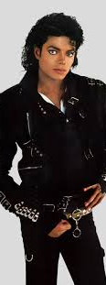



Notes:
Jeu > who has had the most number 1 hits ?

Slide 7
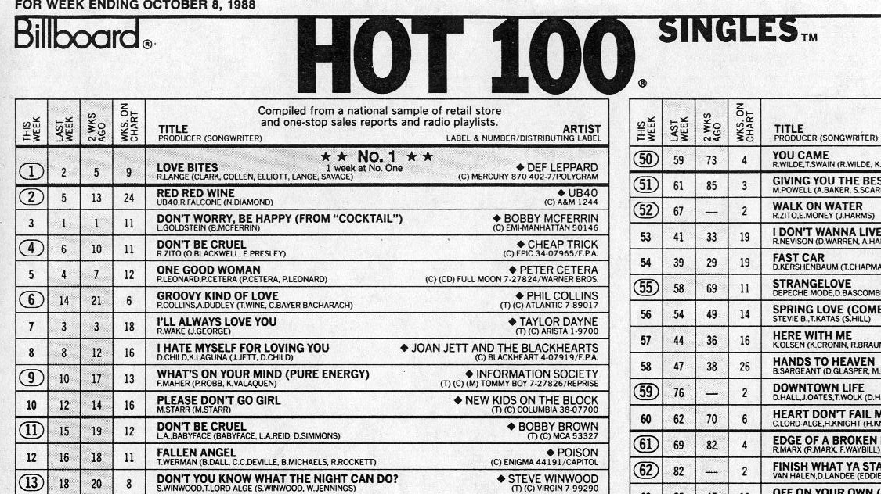


Slide 8
Main data wrangling
Split per decade > From 60’s to 2010’s

Slide 9
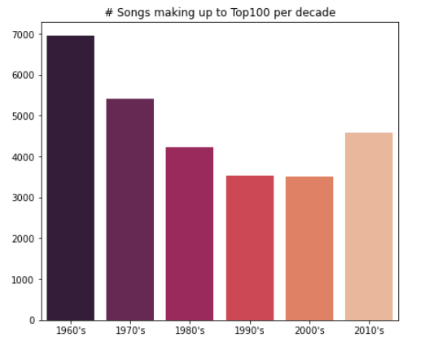
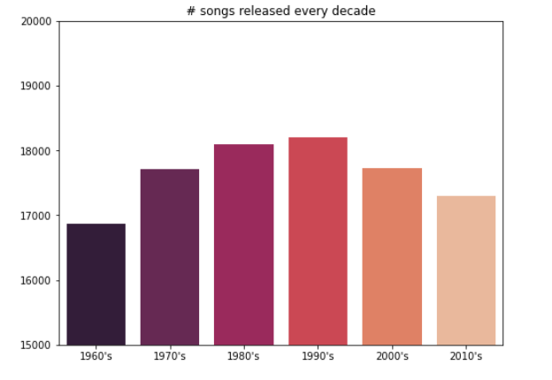
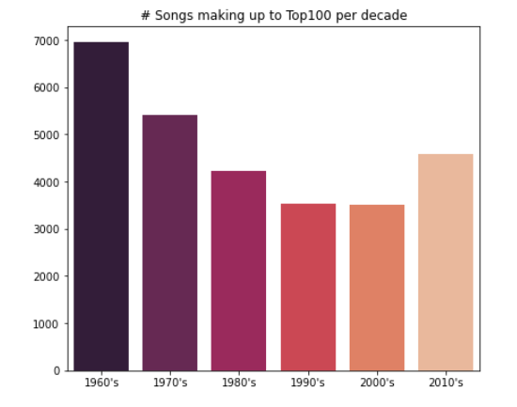
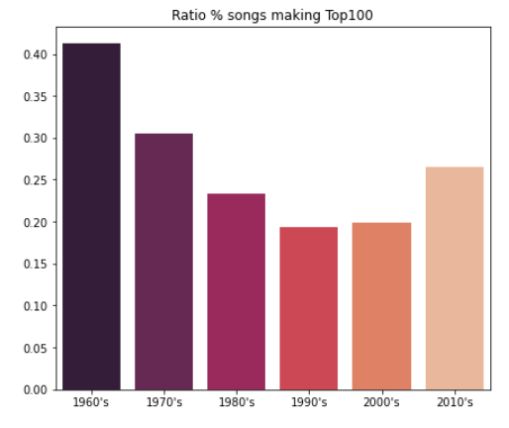
Notes:
Mauvais côtes du decoupage en decade >> artists coupes sur deux decades…

Slide 10
Main data wrangling
Split per decade > From 60’s to 2010’s
Performer ID creation > Solos, Duets and Featurings

Slide 11
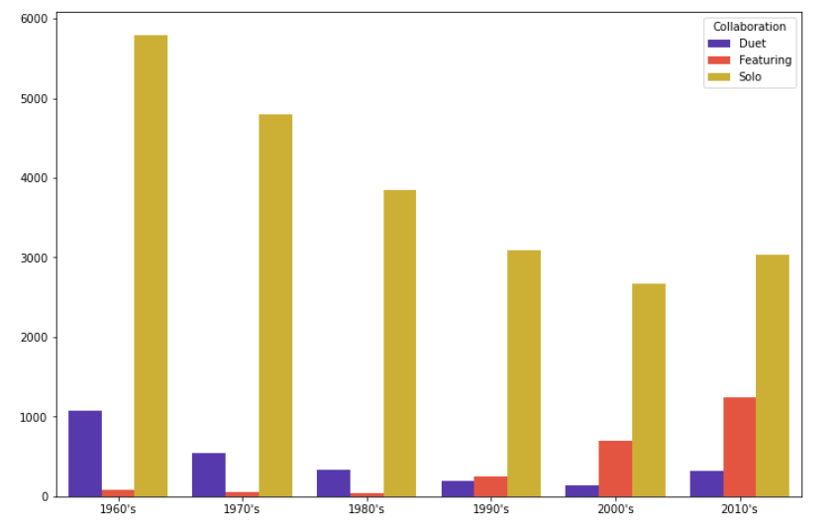
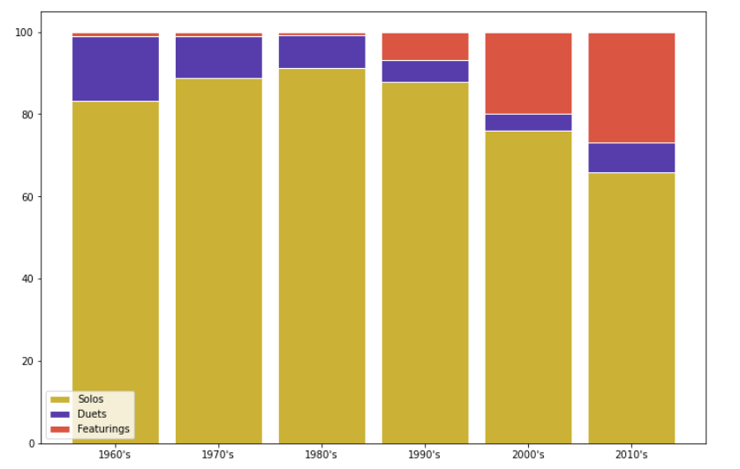
Notes:
Histoire du Featuring

Slide 12



Slide 13
Main data wrangling
Split per decade > From 60’s to 2010’s
Performer ID creation > Solos, Duets and Featurings
Merge with the spotify dataset > 12000 songs in common

Slide 14
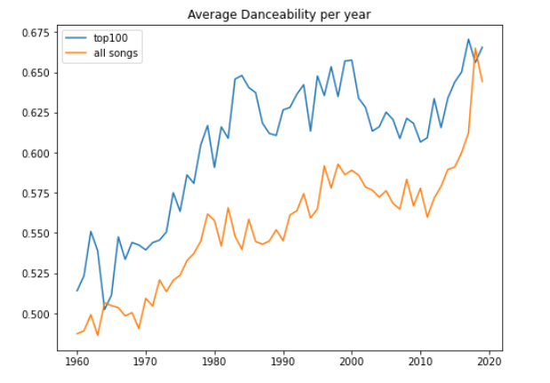

Slide 15


Slide 16
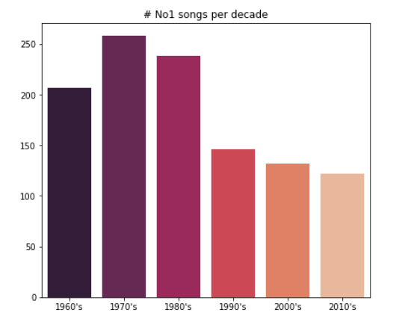
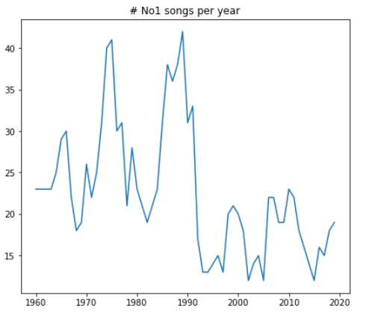
Notes:
First = Much less no1 songs than before while more songs enter Top100

Slide 17
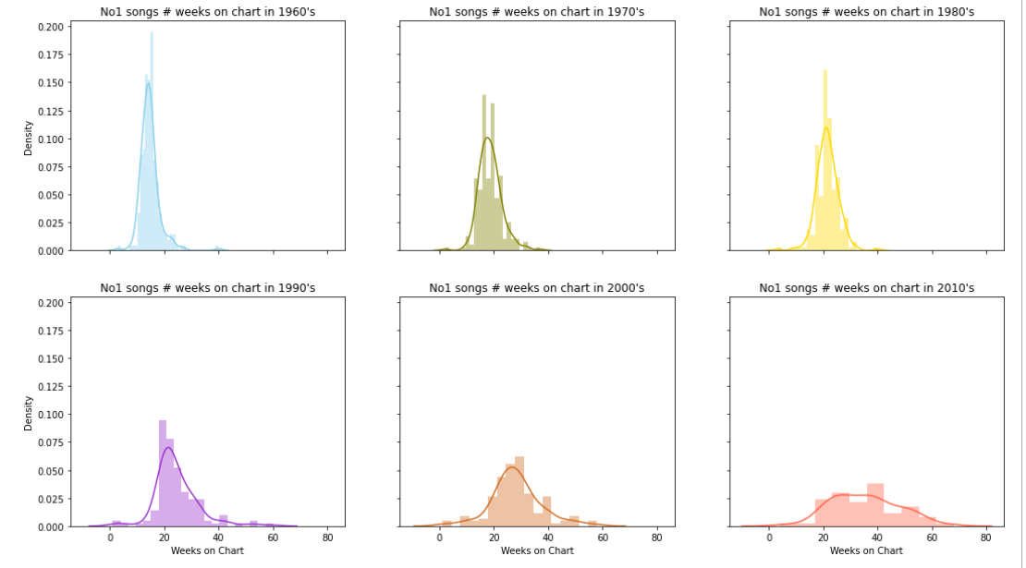
Notes:
Second = No1 trust charts much more than before…

Slide 18
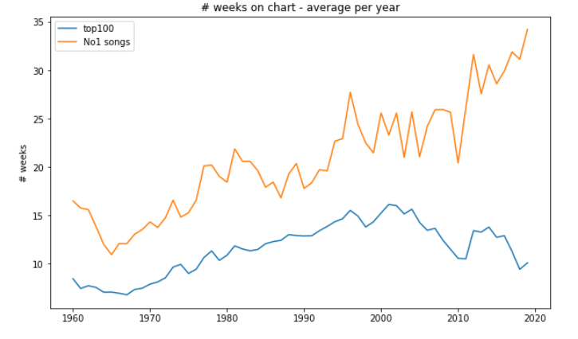
Notes:
… and much more than non no1 songs !

Slide 19
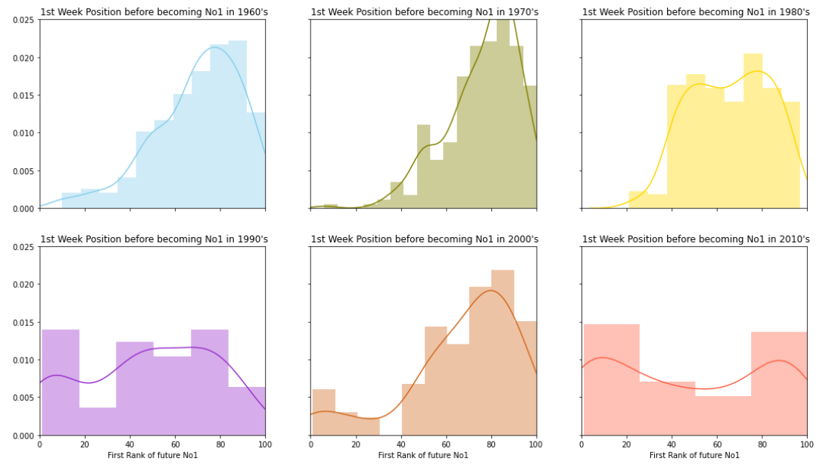
Notes:
Third = No1 songs now get No1 much quicker !

Slide 20
CONCLUSION
Despite more songs get a chance to enter Top100, less and less get No1.
But becoming No1 means to stay on charts much longer.
So game is ON like never !

Slide 21
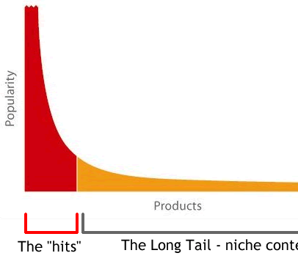
Long Tail curved than never

Slide 22
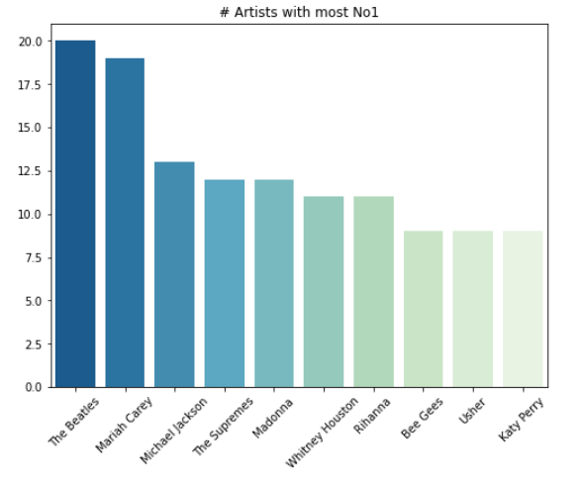

Slide 23




Next step & Thank you
Interactive Dashboard
Make finer analysis per singer
Web Scrapping from https://kworb.net/
Road to Machine Learning with Spotify Data ?
Frédéric Zalma
frederic.zalma@gmail.com
Fredz_projects

